Slide 1
Quantum Computation of Hubbard Model using IBM Q

Slide 2
Two sites Hubbard Model

Slide 3
Outline
Definitions and J-V Transform
Benchmark: analytical and spin solution
Quantum circuit implementation
Quantum circuit optimization
Avoid 3-bodies component
2° order S-T
Tests on real HW
Data model on DB
Optimization tests
Expectation value corrections: amplitude correction factor
Transpiling optimization level
Processor topology: best chip selection
Runs on real HW
IBM Q Team Yorktown & Zurich feedbacks
Error mitigation
Gates characterization: R & CNOT
Qiskit Ignis Measurement Error Mitigation
Mitigated real HW runs
Outcomes & next steps

Slide 4
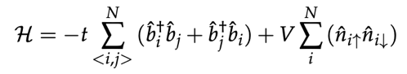
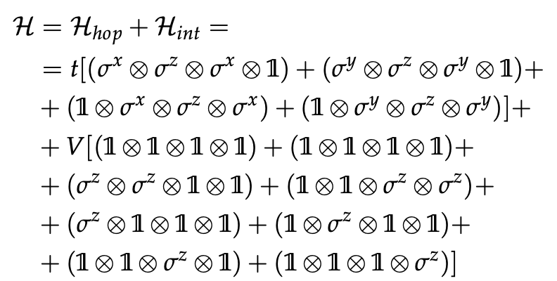
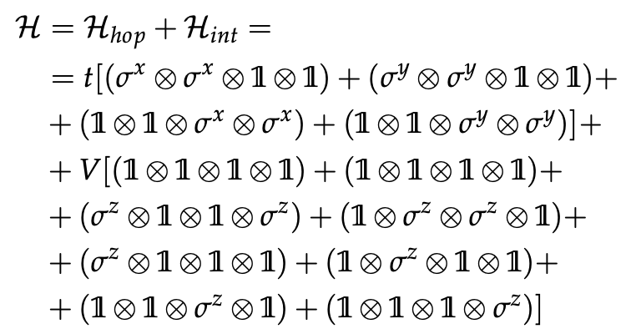
Definitions & J-V Transform
2 sites HM – Introduction
Fermionic hamiltonian
Problem mapping
Spin hamiltonian
2
2
1
1
4
3
2
1
q0
q1
q2
q3
Mapping 1
hopping
interaction
qubit
mapping
1
2
2
1
4
3
2
1
q0
q1
q2
q3
Mapping 2
hopping
interaction
qubit
mapping

Slide 5
Benchmark
Mapping 1 and Mapping 2
Fermionic exact vs Spin exact
Spin exact vs Spin trotter
Spin exact vs Spin trotter – High nTrot
Right J-V Transformation
See backup slides

Slide 6
Quantum circuit implementation
Tests on Mapping 1
2
2
1
1
4
3
2
1
q0
q1
q2
q3
Mapping 1
hopping
interaction
qubit
mapping

Slide 7
Spin hamiltonian to quantum circuit
Quantum circuit implementation
Mapping 1
Full circuit
Time variable in Hopping terms Rz: T*delta
Time variable in Interaction terms Rz: V*delta
Hopping term
Interaction term
t_delta = 1/2;
v_delta = 1/4;

Slide 8
Spin exact vs trotter vs quantum simulated
Quantum circuit implementation
Mapping 1
Initial state 1100, T=1, V=0, n1, nT=1
Initial state 1100, T=2, V=1, n1, nT=3
Initial state 1100, T=4, V=1, n1, nT=5
('u3', 30), ('cx', 17), ('measure', 1)
('u3', 90), ('cx', 51), ('measure', 1)
('u3', 150), ('cx', 85), ('measure', 1)
Initial state 1100, T=1, V=2, n1, nT=3
Initial state 1100, T=1, V=2, n1, nT=5
Initial state 1100, T=1, V=4, n1, nT=5
('u3', 90), ('cx', 51), ('measure', 1)
('u3', 150), ('cx', 85), ('measure', 1)
('u3', 150), ('cx', 85), ('measure', 1)

Slide 9
Quantum circuit optimization
Avoiding 3-bodies components
2° order Suzuki-Trotter decomposition

Slide 10
Optimizations required Results
Quantum circuit optimization
Avoiding 3-bodies components
Three-body terms in the hopping term do not carry any information: sigma_z can be replaced with identity in hopping term. Three-body terms become important when considering more than 2 sites (multiple hopping)
2° order Suzuki-Trotter decomposition
Hopping term works well with 1 Trotter step: interaction term carries on differences and need to use more Trotter steps. While only a few Trotter steps can be implemented (cx gates less than 50), we need to increase performances by adding a Trotter step only to the term with less cx gates (interaction term)
Same behaviour for 2 sites Hubbard Model, less gates
This cannot be used on a 3 sites frustrated triangle Hubbar Model
No changes in performances

Slide 11
Avoiding 3-bodies components
Quantum circuit optimization
Mapping 1
Optimized circuit
Three-body terms do not carry any information: sigma_z can be replaced with identity in hopping term
Hopping term
Interaction term

Slide 12
Avoiding 3-bodies components
Quantum circuit optimization
Mapping 1
COMPLETE
OPTIMIZED (avoiding 3-bodies)
Initial state 1100, T=1, V=1, n1, nT=3
Initial state 1100, T=1, V=1, n1, nT=3
NO TRANSPILING
Circuit Depth: 93
('cx', 60), ('rz', 30), ('ry', 24), ('rx', 24), ('u3', 2), ('measure', 1)
Single: 81 – Double: 60
NO TRANSPILING
Circuit Depth: 44
('cx', 36), ('rz', 30), ('ry', 24), ('rx', 24), ('u3', 2), ('measure', 1)
Single: 81 – Double: 36
Same performances,
less gates
TRANSPILED LEVEL 3
Circuit Depth: 87
('u3', 90), ('cx', 51), ('measure', 1)
Single: 91 – Double: 51
TRANSPILED LEVEL 3
Circuit Depth: 39
('u3', 65), ('cx', 36), ('measure', 1)
Single: 66 – Double: 36

Slide 13
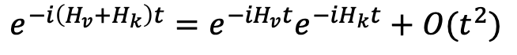
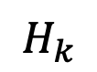
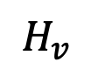
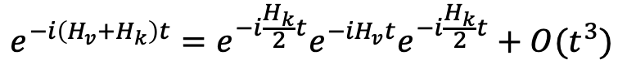
2° order Suzuki-Trotter decomposition
Quantum circuit optimization
Mapping 1
OPTIMIZED (with 2° order S-T) on Hk
$$e^{−i\left(H_{v}+H_{k}\right)t}=e^{−{iH}_{v}t}e^{−{iH}_{k}t}+O(t^{2})$$
Initial state 1100, T=1, V=1, n1, nT=2
$$H_{v}$$
carries 4 CNOT (2 in parallel)
$$H_{k}$$
(optimized) carries 8 CNOT (in series)
Seems that at low nTrot the 2° order S-T fails sooner
Gain in performance at high times
No significant gain at low-middle times
$$e^{−i\left(H_{v}+H_{k}\right)t}=e^{−i\frac{H_{k}}{2}t}e^{−{iH}_{v}t}e^{−i\frac{H_{k}}{2}t}+O(t^{3})$$
Initial state 1100, T=1, V=1, n1, nT=3
2° order S-T on Hv was not possible

Slide 14
Quantum circuit implementation
Tests on Mapping 2
1
2
2
1
4
3
2
1
q0
q1
q2
q3
Mapping 2
hopping
interaction
qubit
mapping

Slide 15
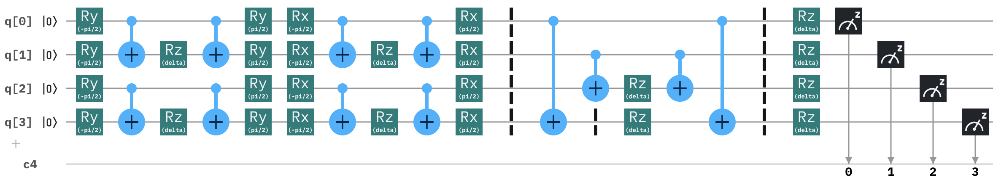
Optimized mapping
Quantum circuit optimization
Mapping 2
New circuit
By changing the mapping we can parallelize many CNOTs and reduce circuit complexity
Hopping term
Interaction term

Slide 16
Mapping 1 vs Mapping 2
Quantum circuit optimization
Mapping 1
Initial state 1100, T=1, V=1, n1, nT=3
No 2° order S-T
Transpiling L0
Mapping 2
Initial state 1001, T=1, V=1, n1, nT=3
No 2° order S-T
Transpiling L0
Circuit Depth: 44, ('u3', 80), ('cx', 36), ('measure', 1)
Circuit Depth: 44, ('u3', 80), ('cx', 36), ('measure', 1)
Mapping 1 and 2 give the same results

Slide 17
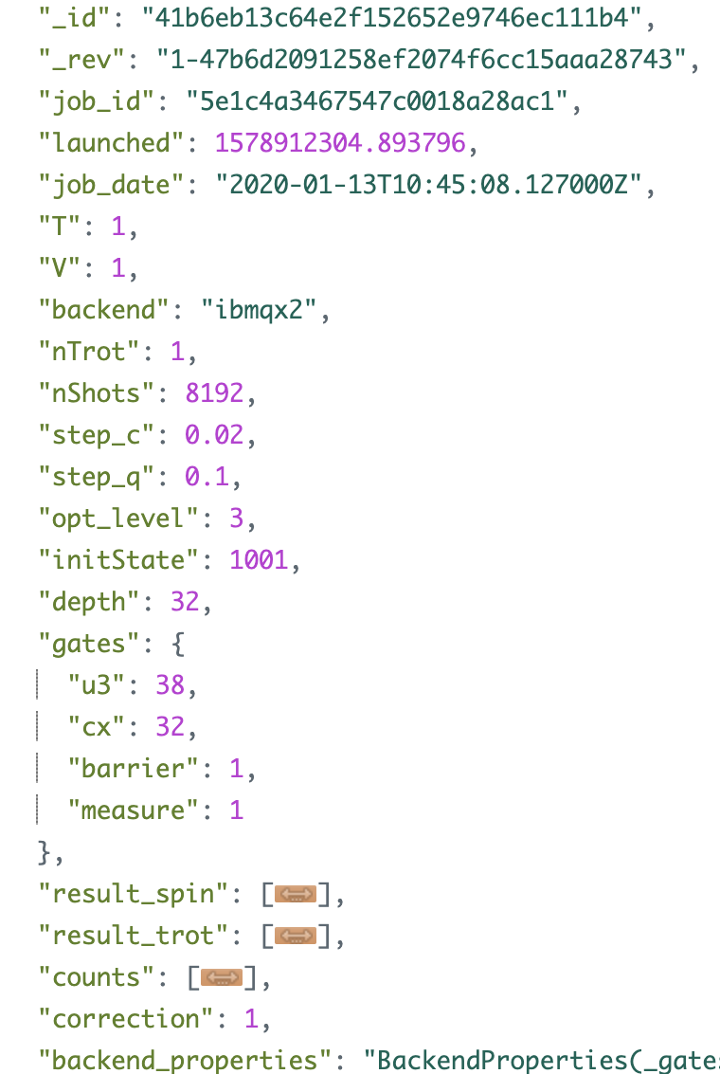
Tests on real HW
Results are stored in a IBM Cloudant DB
Run parameters
Circuit data
Results
Chip calibration data

Slide 18
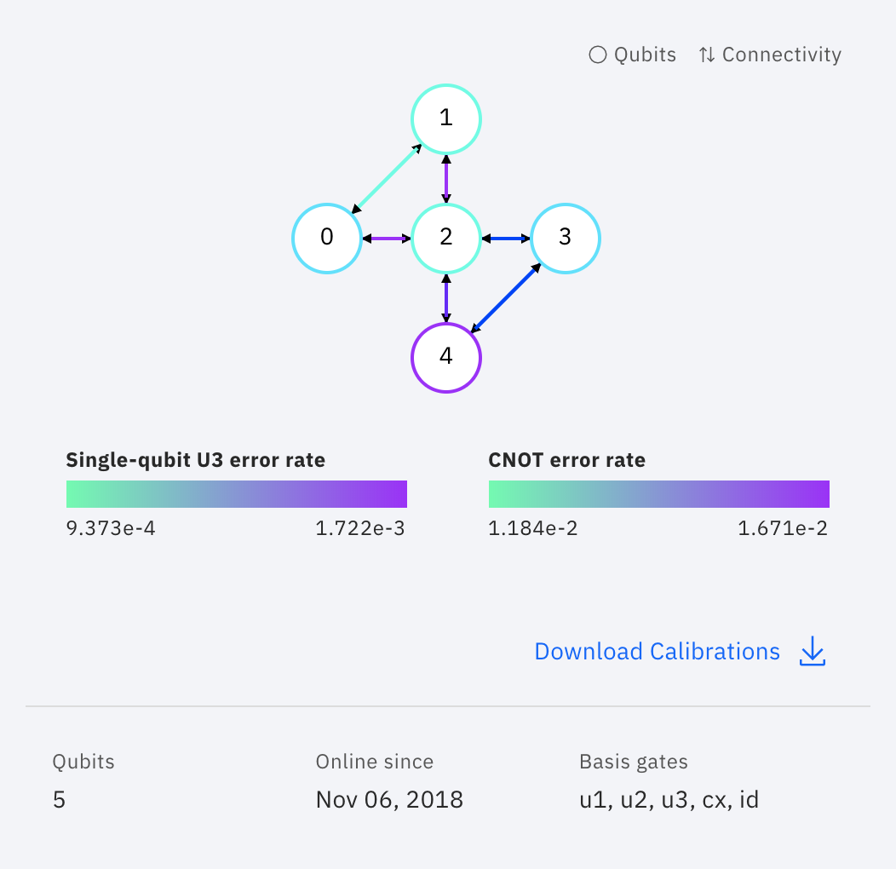
Run on real hardware
Tests on real HW
Mapping 1
ibmq_qasm_simulator
ibmq_5_yorktown - ibmqx2 v2.0.0
Initial state 1100, T=1, V=1, n1, nT=1
Initial state 1100, T=1, V=1, n1, nT=1
"_id": "097fba57f1443a0f130bc76a706c9cd2",
"_id": "5bfdb94cd6c5d28924397ab283722e84",
NO TRANSPILING
Circuit Depth: 16
('cx', 12), ('rz', 10), ('ry', 8), ('rx', 8), ('u3', 2), ('measure', 1)
Single: 29 – Double: 12
NO TRANSPILING
Circuit Depth: 16
('cx', 12), ('rz', 10), ('ry', 8), ('rx', 8), ('u3', 2), ('measure', 1)
Single: 29 – Double: 12
TRANSPILED LEVEL 3
Circuit Depth: 13
('u3', 21), ('cx', 12), ('measure', 1)
Single: 22 – Double: 12
TRANSPILED LEVEL 3
Circuit Depth: 13
('u3', 21), ('cx', 12), ('measure', 1)
Single: 22 – Double: 12

Slide 19
Run on real hardware
Tests on real HW
Mapping 1
ibmq_qasm_simulator
ibmq_5_yorktown - ibmqx2 v2.0.0
Initial state 1100, T=1, V=1, n1, nT=2
Initial state 1100, T=1, V=1, n1, nT=2
"_id": "0e6f2f02102eba0643e8fc69cda9e303",
"_id": "0e6f2f02102eba0643e8fc69cdaa448d",
NO TRANSPILING
Circuit Depth: 30
('cx', 24), ('rz', 20), ('ry', 16), ('rx', 16), ('u3', 2), ('measure', 1)
Single: 55 – Double: 24
NO TRANSPILING
Circuit Depth: 30
('cx', 24), ('rz', 20), ('ry', 16), ('rx', 16), ('u3', 2), ('measure', 1)
Single: 55 – Double: 24
TRANSPILED LEVEL 3
Circuit Depth: 26
('u3', 43), ('cx', 24), ('measure', 1)
Single: 44 – Double: 24
TRANSPILED LEVEL 3
Circuit Depth: 26
('u3', 43), ('cx', 24), ('measure', 1)
Single: 44 – Double: 24

Slide 20
Comments
Tests on real HW
First point not aligned: in some runs the first point (for angle 0) is not aligned to 1
Data shift: in some nTrot = 1 runs, data oscillations are shifted from theory
Amplitude scale: each run present different scaling factor

Slide 21
Optimization tests
Expectation value corrections: best amplitude correction factor
We expect that the calculation output can be corrected to match the theoretical distribution
This correction is a multiplication factor applied to each point
The correction factor acts on an overall correction on amplitude: even if it cannot be easily calculated a priori, it can be calculated a posteriori to prove that quantum calculated points follow the expected shape
Maybe some machine learning algorithms can be leveraged on calibration data to calculate corrections
Used qubit vs processor topology: best transpiling option
Transpiling automatically selects qubits used in calculation
Some tests are performed to optimize qubits selection
Gates characterization: best set of parameters to correct rotation axes
By considering eventual tilt angles / systematic errors, actual rotations can be corrected
For a single rotation R gate we should use 5 U gates, increasing drammatically circuit size
pr3["res"] = (1-correction*(pr3['0000']-pr3['1000'])/nShots)/2

Slide 22
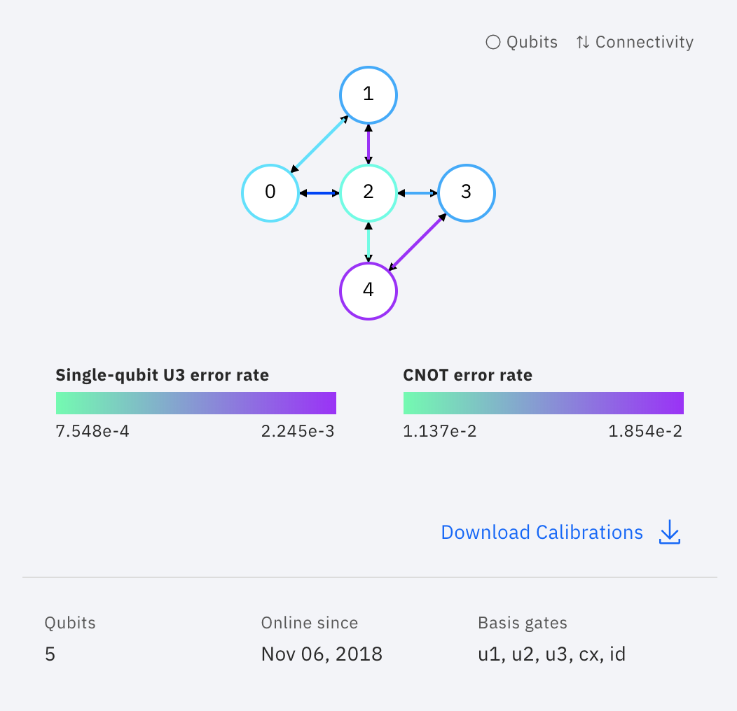
Expectation value corrections
Optimization tests
Mapping 1
ibmq_5_yorktown - ibmqx2 v2.0.0
Initial state 1100, T=1, V=1, n1, nT=2
Initial state 1100, T=1, V=1, n1, nT=2
Initial state 1100, T=1, V=1, n1, nT=2
"_id": "f8679e3ac7194dd57003f39d0c2b7c2d"
"_id": "dea7c660df7e5bf1a75a762e86e5a3b7"
"_id": "addc456ebbf4219a73d83cf0dae52bad"
CORRECTION FACTOR 4
TRANSPILE L0
"depth": 42,
"gates": {
"u3": 54,
"cx": 45,
"barrier": 1,
"measure": 1
}
CORRECTION FACTOR 3.3
TRANSPILE L1
"depth": 39,
"gates": {
"u3": 44,
"cx": 39,
"barrier": 1,
"measure": 1
}
CORRECTION FACTOR 1.5
TRANSPILE L2
"depth": 36,
"gates": {
"u3": 44,
"cx": 39,
"barrier": 1,
"measure": 1
}
(*) details in next slide

Slide 23
Expectation value corrections vs Transpile level
Optimization tests
Mapping 1
ibmq_5_yorktown - ibmqx2 v2.0.0
(*)
Initial state 1100, T=1, V=1, n1, nT=2
CORRECTION FACTOR: 2 to 5, 0.25 step
"_id": "91ab8052194475bafc661f05ae27c7d8"
CORRECTION FACTOR 2.9
TRANSPILE L1
"depth": 39,
"gates": {
"cx": 45,
"u3": 44,
"barrier": 1,
"measure": 1
},

Slide 24
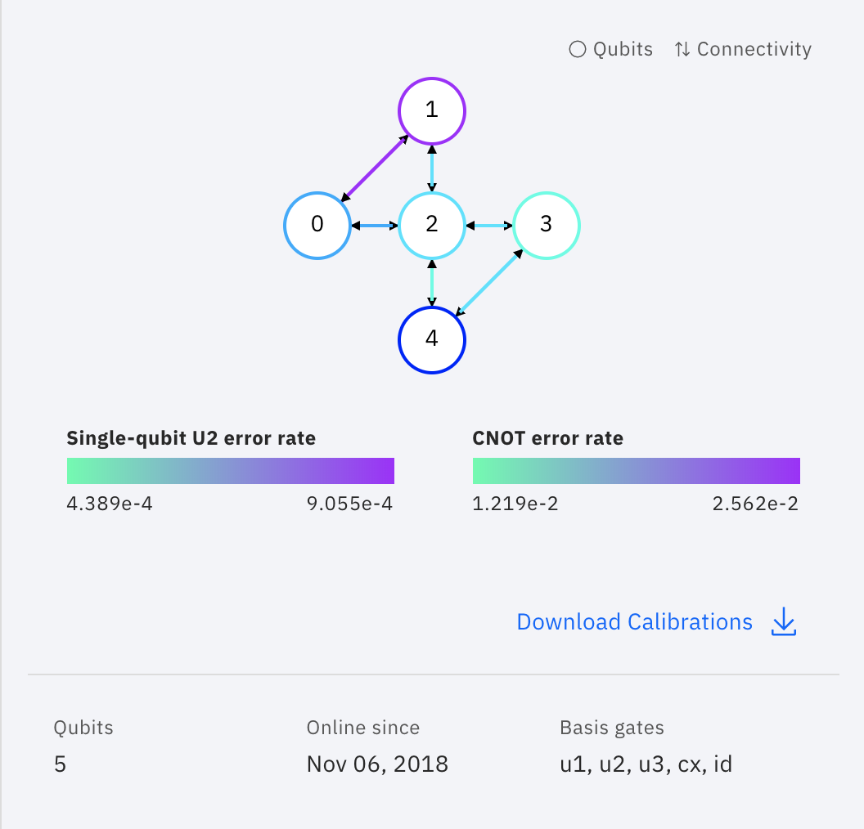
Expectation value corrections vs Transpile level
Optimization tests
Mapping 1
ibmq_5_yorktown - ibmqx2 v2.0.0
Initial state 1100, T=1, V=1, n1, nT=3
Initial state 1100, T=1, V=1, n1, nT=3
"_id": "036d189a68ed5e7855dd8f4deb0cba74"
"_id": "f741f956f9e03b8c2f052a34f9897134"
CORRECTION FACTOR 20
TRANSPILE L3
"depth": 58,
"gates": {
"u3": 66,
"cx": 63,
"barrier": 1,
"measure": 1
},
CORRECTION FACTOR 5
TRANSPILE L0
"depth": 62,
"gates": {
"u3": 80,
"cx": 66,
"barrier": 1,
"measure": 1
},
CORRECTION FACTOR: 1 to 30, 2 step
CORRECTION FACTOR: 1 to 5, 0.5 step

Slide 25
Used qubit vs processor topology
Optimization tests
Qubit mapping
The «compiler» uses the qubit allowed by the processor topology, adding several SWAP gates. Probably this feature can be disabled in order to try to select manually the right qubits avoiding the SWAP gates.
If qubits are not connected, add SWAP gates. Possibility to map manually
Trivial layout: Map virtual qubits to the same numbered physical qubit on the device, i.e. [0,1,2,3,4] -> [0,1,2,3,4] (default in optimization_level=0)
Dense layout: Find the sub-graph of the device with same number of qubits as the circuit with the greatest connectivity (default in optimization_level=1)
Noise adaptive layout: Uses the noise properties of the device, in concert with the circuit properties, to generate the layout with the best noise properties (default in optimization_level=2 and optimization_level=3)
The choice of initial layout is extremely important when:
1) Computing the number of SWAP operations needed to map the input circuit onto the device topology
2) Taking into account the noise properties of the device
https://github.com/Qiskit/qiskit-iqx-tutorials/blob/master/qiskit/fundamentals/5_using_the_transpiler.ipynb

Slide 26
Used qubit vs processor topology
Optimization tests
Mapping 1
ibmq_5_yorktown - ibmqx2 v2.0.0
Initial state 1100, T=1, V=1, n1, nT=2
qubit 1: highest error
cx(0,1): highest error
REQUIRED CX
(0-2) x4 -> connected
(1-3) x4 -> indirect
(0-1) x2 -> connected
(2-3) x2 -> connected
"_id": "8cec0388abfe68b62a5aa6bf313325d5"
CORRECTION FACTOR 1.7
initial_layout = [0,1,2,3]
"depth": 39,
"gates": {
"u3": 44,
"cx": 42,
"barrier": 1,
"measure": 1
},
q0
q1
q2
q3

Slide 27
Used qubit vs processor topology
Optimization tests
Mapping 1
ibmq_5_yorktown - ibmqx2 v2.0.0
Initial state 1100, T=1, V=1, n1, nT=2
REQUIRED CX
(0-2) x4 -> connected
(4-3) x4 -> connected
(0-4) x2 -> indirect
(2-3) x2 -> connected
"_id": "8cec0388abfe68b62a5aa6bf313325d5"
CORRECTION FACTOR 4.5
initial_layout = [0,4,2,3]
"depth": 36,
"gates": {
"u3": 44,
"cx": 36,
"barrier": 1,
"measure": 1
},
q0
q1
q2
q3
Not accurate even if better qubit status
Possible shift
Problems on 0
Calibration issues or run statistical noise

Slide 28
Used qubit vs processor topology
Optimization tests
Mapping 1
ibmq_5_yorktown - ibmqx2 v2.0.0
Initial state 1100, T=1, V=1, n1, nT=2
REQUIRED CX
(0-2) x4
(1-3) x4
(0-1) x2
(2-3) x2
"_id": "9afe611929c0f3526a56d1f6a9324841"
CORRECTION FACTOR 4
TRANSPILE L3
"depth": 39,
"gates": {
"u3": 44,
"cx": 42,
"barrier": 1,
"measure": 1
},
q0
q1
q2
q3
Problems on 0
CORRECTION FACTOR: 1 to 5, 0.5 step

Slide 29
Real runs on IBM Q HW
1
2
2
1
4
3
2
1
q0
q1
q2
q3
Runs performed using:
Optimized mapping (Mapping 2)
2° order Suzuki-Trotter on kinetic term
Amplitude correction factors
Transpiling L3 / Initial Layout
Results:
Calculation of n1
T ~ V range
1 ~ 3 nTrot + 2° order on Kinetic term
Mapping 2
hopping
interaction
qubit
mapping
Hopping term
Interaction term

Slide 30
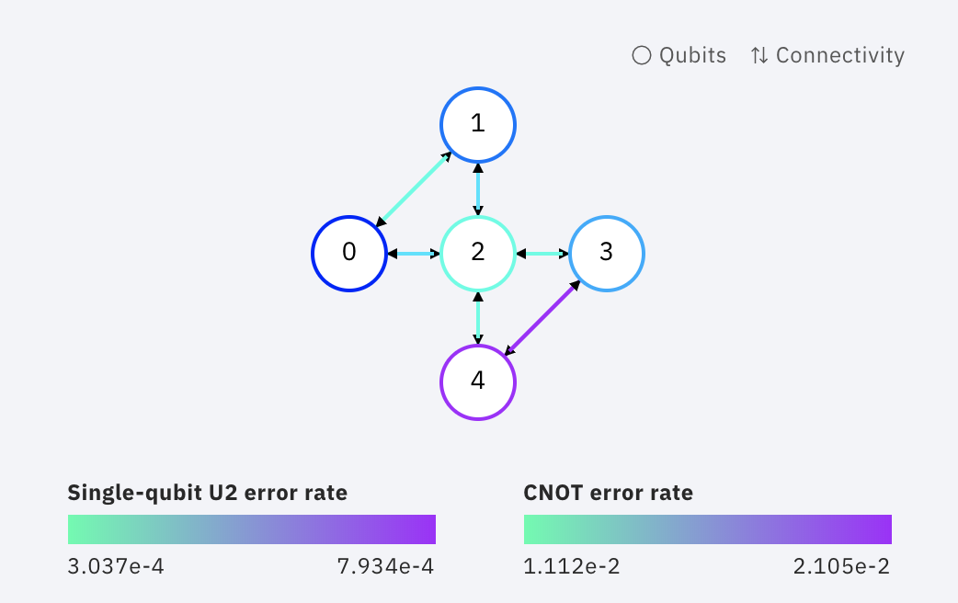
2 sites Hubbard HW run results
Real runs
“1.5 Trotter steps”
Mapping 2
ibmq_5_yorktown - ibmqx2 v2.0.0
REQUIRED CX
(0-1) x4 direct
(2-3) x4 direct
(0-3) x2 indirect
(1-2) x2 direct
ibmq_5_yorktown - ibmqx2 v2.0.0
Initial state 1001, T=1, V=1, n1, nT=1+2°ordK
Initial state 1001, T=1, V=1, n1, nT=1+2°ordK
"_id": "6573036740aa03305ffb74375e824b54"
"_id": "41b6eb13c64e2f152652e9746ec111b4"
NO CORRECTION
initial_layout = [0,1,2,3]
"depth": 29,
"gates": {
"u3": 38,
"cx": 26,
"barrier": 1,
"measure": 1
}
NO CORRECTION
TRANSPILE L3
"depth": 32,
"gates": {
"u3": 38,
"cx": 32,
"barrier": 1,
"measure": 1
}
CORRECTION FACTOR 0.8
initial_layout = [0,1,2,3]
"depth": 29,
"gates": {
"u3": 38,
"cx": 26,
"barrier": 1,
"measure": 1
}
CORRECTION FACTOR 0.8
TRANSPILE L3
"depth": 32,
"gates": {
"u3": 38,
"cx": 32,
"barrier": 1,
"measure": 1
}

Slide 31
2 sites Hubbard HW run results
Real runs
“2 Trotter steps”
Mapping 2
ibmq_5_yorktown - ibmqx2 v2.0.0
REQUIRED CX
(0-1) x4 direct
(2-3) x4 direct
(0-3) x2 indirect
(1-2) x2 direct
ibmq_5_yorktown - ibmqx2 v2.0.0
Initial state 1001, T=1, V=1, n1, nT=2
Initial state 1001, T=1, V=1, n1, nT=2
"_id": "4ac36b4a849b66300aabdbd030aa946c"
"_id": "4ac36b4a849b66300aabdbd0301b4015"
NO CORRECTION
initial_layout = [0,1,2,3]
"depth": 36,
"gates": {
"u3": 44,
"cx": 39,
"barrier": 1,
"measure": 1
}
NO CORRECTION
TRANSPILE L3
"depth": 39,
"gates": {
"u3": 44,
"cx": 36,
"barrier": 1,
"measure": 1
}
CORRECTION FACTOR 1.5
initial_layout = [0,1,2,3]
"depth": 36,
"gates": {
"u3": 44,
"cx": 39,
"barrier": 1,
"measure": 1
}
CORRECTION FACTOR 3.5
TRANSPILE L3
"depth": 39,
"gates": {
"u3": 44,
"cx": 36,
"barrier": 1,
"measure": 1
}

Slide 32
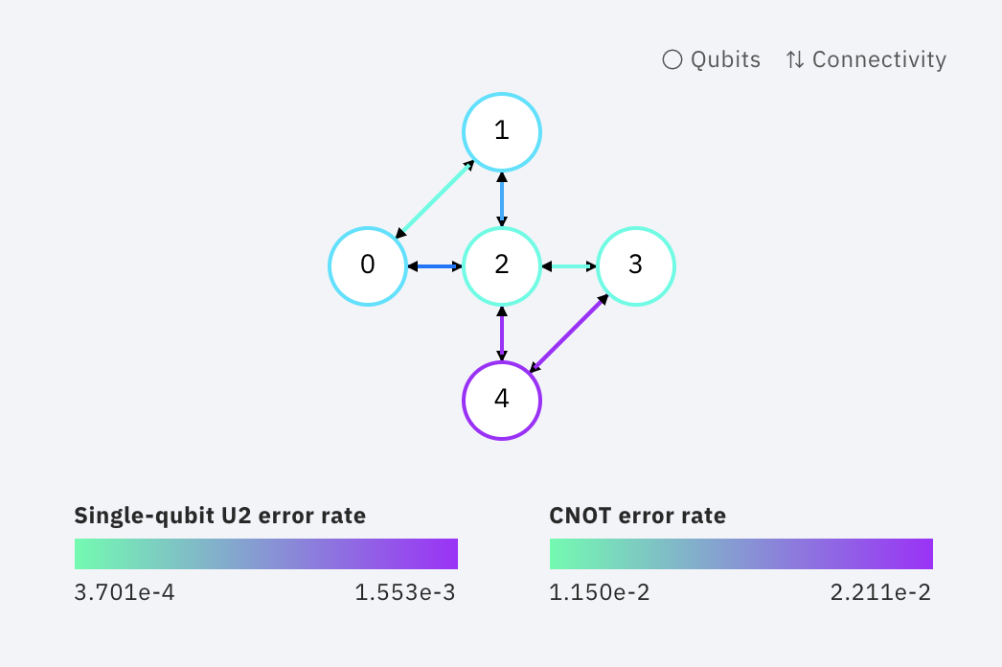
2 sites Hubbard HW run results
Real runs
“2.5 Trotter steps”
Mapping 2
ibmq_5_yorktown - ibmqx2 v2.0.0
REQUIRED CX
(0-1) x4 direct
(2-3) x4 direct
(0-3) x2 indirect
(1-2) x2 direct
ibmq_5_yorktown - ibmqx2 v2.0.0
Initial state 1001, T=1, V=1, n1, nT=2+2°ordK
Initial state 1001, T=1, V=1, n1, nT=2+2°ordK
"_id": "76986efb583cf5ae092071f28c21f3d8"
"_id": "7fced1b1e562431aa24b58b0efe23a38"
NO CORRECTION
initial_layout = [0,1,2,3]
"depth": 56,
"gates": {
"u3": 72,
"cx": 55,
"barrier": 1,
"measure": 1
}
NO CORRECTION
TRANSPILE L3
"depth": 59,
"gates": {
"u3": 72,
"cx": 64,
"barrier": 1,
"measure": 1
}
CORRECTION FACTOR 1.5
initial_layout = [0,1,2,3]
"depth": 56,
"gates": {
"u3": 72,
"cx": 55,
"barrier": 1,
"measure": 1
}
CORRECTION FACTOR 2.5
TRANSPILE L3
"depth": 59,
"gates": {
"u3": 72,
"cx": 64,
"barrier": 1,
"measure": 1
}

Slide 33
2 sites Hubbard HW run results
Real runs
“3 Trotter steps”
Mapping 2
ibmq_5_yorktown - ibmqx2 v2.0.0
REQUIRED CX
(0-1) x4 direct
(2-3) x4 direct
(0-3) x2 indirect
(1-2) x2 direct
ibmq_5_yorktown - ibmqx2 v2.0.0
Initial state 1001, T=1, V=1, n1, nT=3
Initial state 1001, T=1, V=1, n1, nT=3
"_id": "93db0ff697dd9c94ab5dd45c5efa13ad"
"_id": "c9d77ae9b737f32bb05e26f35bc84e00"
NO CORRECTION
initial_layout = [0,1,2,3]
"depth": 55,
"gates": {
"u3": 66,
"cx": 57,
"barrier": 1,
"measure": 1
}
NO CORRECTION
TRANSPILE L3
"depth": 58,
"gates": {
"u3": 66,
"cx": 63,
"barrier": 1,
"measure": 1
}
CORRECTION FACTOR 2
initial_layout = [0,1,2,3]
"depth": 55,
"gates": {
"u3": 66,
"cx": 57,
"barrier": 1,
"measure": 1
}
CORRECTION FACTOR 4
TRANSPILE L3
"depth": 58,
"gates": {
"u3": 66,
"cx": 63,
"barrier": 1,
"measure": 1
}

Slide 34
2 sites Hubbard HW run results
Real runs
“3.5 Trotter steps”
Mapping 2
ibmq_5_yorktown - ibmqx2 v2.0.0
REQUIRED CX
(0-1) x4 direct
(2-3) x4 direct
(0-3) x2 indirect
(1-2) x2 direct
ibmq_5_yorktown - ibmqx2 v2.0.0
Initial state 1001, T=1, V=1, n1, nT=3+2°ordK
Initial state 1001, T=1, V=1, n1, nT=3+2°ordK
"_id": "971a007c0ccd73849eb9f7addbd756d5"
"_id": "2eb901b9649890e5df0fb28594f58efa"
NO CORRECTION
initial_layout = [0,1,2,3]
"depth": 83,
"gates": {
"u3": 106,
"cx": 87,
"barrier": 1,
"measure": 1
}
NO CORRECTION
TRANSPILE L3
"depth": 86,
"gates": {
"u3": 106,
"cx": 93,
"barrier": 1,
"measure": 1
}
CORRECTION FACTOR 3.5
initial_layout = [0,1,2,3]
"depth": 83,
"gates": {
"u3": 106,
"cx": 87,
"barrier": 1,
"measure": 1
}
CORRECTION FACTOR 5
TRANSPILE L3
"depth": 86,
"gates": {
"u3": 106,
"cx": 93,
"barrier": 1,
"measure": 1
}

Slide 35
IBM Q Team Yorktown & Zurich feedbacks
Real runs
1) Amplitude correction factor
The usage of a correction factor is a trick that can only be used to prove a posteriori (knowing the solution) that calculated points are not casual. Some studies and articles were published with amplitude correction factors and also with points shifting, but it is not the real solution. The point is to understand errors and mitigate them.
2) Gates characterization
The correction of a single rotation gate increases the number of gates by a factor 5. The errors in gates characterizations are both systematic and statistical: systematic errors are being corrected by IBM Q, and statistical errors are impossible to correct.
3) Trotter approach
Yorktown Team does not often use Trotterization, but they are impressed about our results with 2/3 Trotter steps.
Advices:
Move quickly to 3 sites Hubbard Model
Find a way to calculate a priori the correction factor from calibration data that can be used to correct amplitudes
Do not correct gates by implementing characterization results

Slide 36
Error mitigation
Gates characterization: Rx & Ry
Gates characterization: CNOT
Qiskit Ignis: Measurement Error Mitigation

Slide 37
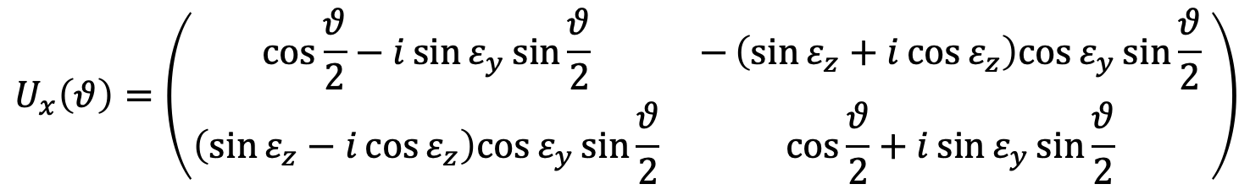
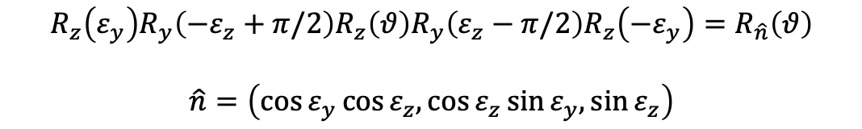
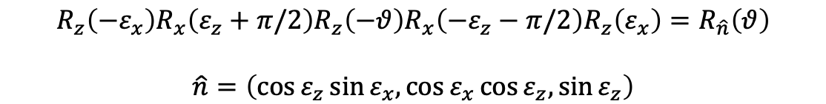
Gates characterization: R on arbitrary axis
Error mitigation
$$U_{x}\left(θ\right)=\left(\begin{matrix}\cos{\frac{θ}{2}−i\sin{ε_{y}\sin{\frac{θ}{2}}}} & −\left(\sin{ε_{z}+i\cos{ε_{z}}}\right)cos{ε_{y}\sin{\frac{θ}{2}}} \\ \left(\sin{ε_{z}−i\cos{ε_{z}}}\right)cos{ε_{y}\sin{\frac{θ}{2}}} & \cos{\frac{θ}{2}+i\sin{ε_{y}\sin{\frac{θ}{2}}}}\end{matrix} \right)$$
Aim: find the best set of parameters epsZ, epsY, epsX to reproduce HW trend on simulations -> will be used to correct rotations (Rx, Ry, Rz) and CNOTs
Axis close to X
Axis close to Y
$$R_{z}\left(ε_{y}\right)R_{y}\left(−ε_{z}+π/2\right)R_{z}\left(θ\right)R_{y}\left(ε_{z}−π/2\right)R_{z}\left(−ε_{y}\right)=R_{\hat{n}}\left(θ\right)$$
$$\hat{n}=\left(\cos{ε_{y}}\cos{ε_{z},\cos{ε_{z}}\sin{ε_{y},}}\sin{ε_{z}}\right)$$
$$R_{z}\left({−ε}_{x}\right)R_{x}\left(ε_{z}+π/2\right)R_{z}\left(−θ\right)R_{x}\left({−ε}_{z}−π/2\right)R_{z}\left(ε_{x}\right)=R_{\hat{n}}\left(θ\right)$$
$$\hat{n}=\left(\cos{ε_{z}}\sin{ε_{x},\cos{ε_{x}}\cos{ε_{z},}}\sin{ε_{z}}\right)$$
Rx(delta)
qc.u1(-epsY, qubit)
qc.u3(-pi/2+epsZ, 0.0, 0.0, qubit)
qc.u1(delta, qubit)
qc.u3(pi/2-epsZ, 0.0, 0.0, qubit)
qc.u1(epsY, qubit)
Ry(delta)
qc.u1(epsX, qubit)
qc.u3(-pi/2-epsZ, -pi/2, pi/2, qubit)
qc.u1(-delta, qubit)
qc.u3(pi/2+epsZ, -pi/2, pi/2, qubit)
qc.u1(-epsX, qubit)

Slide 38
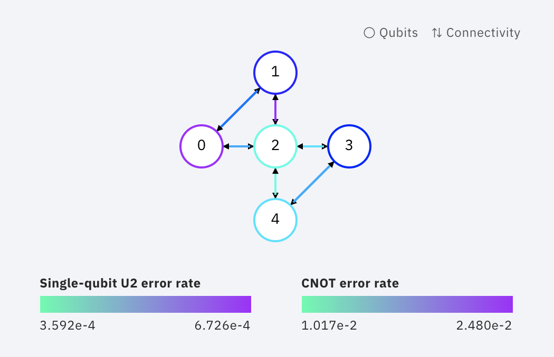
Gates characterization: Rx
Error mitigation
Worst
Medium
ibmq_qasm_simulator
ibmq_5_yorktown - ibmqx2 v2.0.0
Qubit 0
Qubit 1
"_id": "85b6bd4e391f835316b424292e09b5f9",
"_id": "3897b28b0252ac905953c1fde4785bcd",
"_id": "c80e919c5c132dc71fba5d65bae9d9cd",

Slide 39
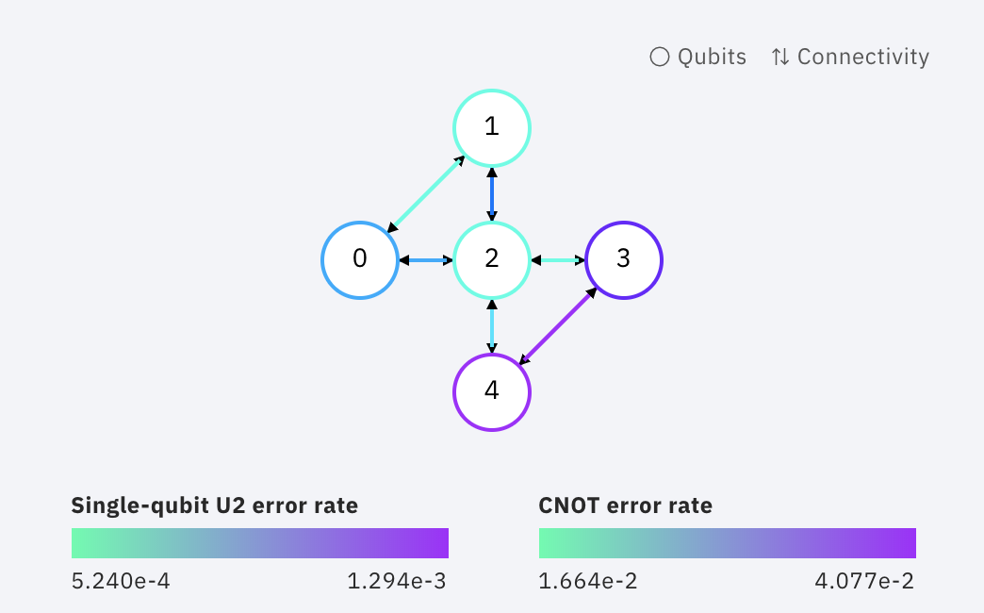
Gates characterization: R ratio plots
Error mitigation
HW Runs vs Parametrized Simulations
Rx
Qubit 0
epsZ = pi/19
epsY = pi/26
epsX = 0
ibmq_5_yorktown - ibmqx2 v2.0.1
Real run reference "_id": "41b97463e714fb18132efff52a8cf837",

Slide 40
Gates characterization: R ratio plots
Error mitigation
HW Runs vs Parametrized Simulations
Ry
Qubit 0
epsZ = pi/14
epsY = 0
epsX = pi/20
ibmq_5_yorktown - ibmqx2 v2.0.1
Real run reference "_id": "7f18c003d6b4e9da1be198a26d539ff4",

Slide 41
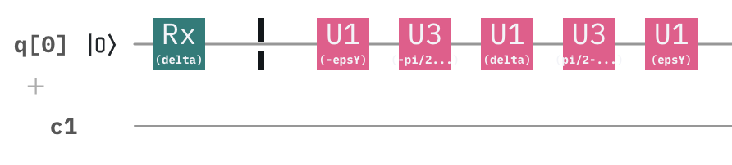
Gates characterization: considerations
Error mitigation
Angles epsX, epsY and epsZ can be found, and to mitigate systematic (tilt) errors on each rotation we need to use 5 gates instead of one.
Only U3 gates introduce errors because U1 are only a system coordinates change
To be implemented on real HW run circuits
Rx(delta)
qc.u1(-epsY, qubit)
qc.u3(-pi/2+epsZ, 0.0, 0.0, qubit)
qc.u1(delta, qubit)
qc.u3(pi/2-epsZ, 0.0, 0.0, qubit)
qc.u1(epsY, qubit)
Ry(delta)
qc.u1(epsX, qubit)
qc.u3(-pi/2-epsZ, -pi/2, pi/2, qubit)
qc.u1(-delta, qubit)
qc.u3(pi/2+epsZ, -pi/2, pi/2, qubit)
qc.u1(-epsX, qubit)

Slide 42
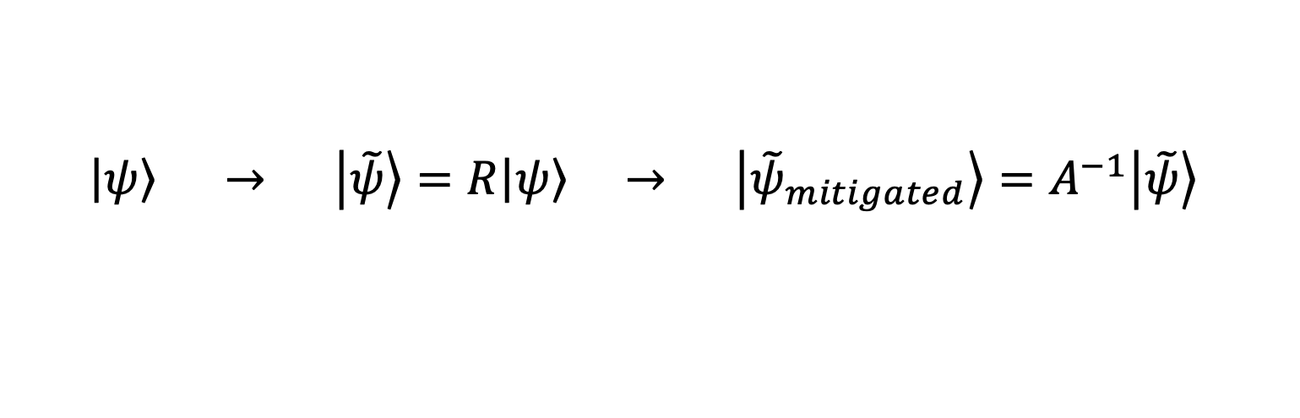
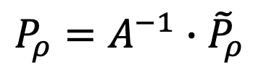
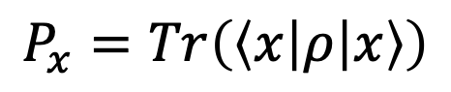
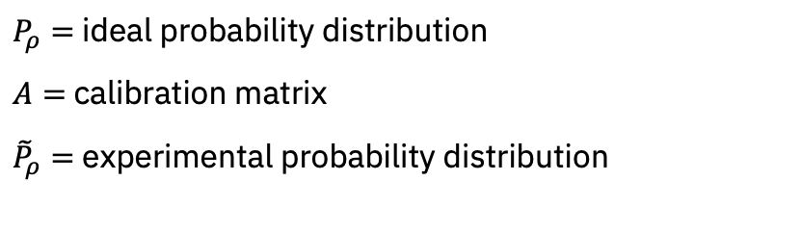
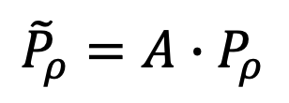
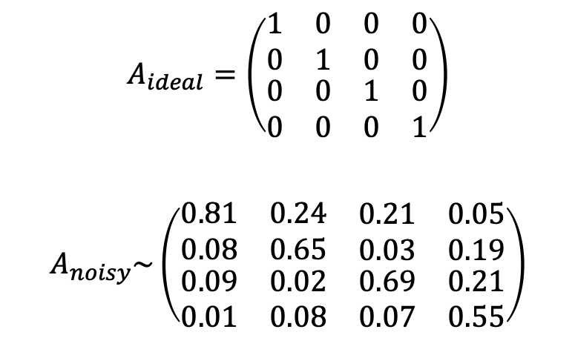
Error Mitigation with Qiskit Ignis
Error mitigation
Approfondire teoria
$$A_{ideal}=\left(\begin{matrix}\begin{matrix}1 & 0 \\ 0 & 1\end{matrix} & \begin{matrix}0 & 0 \\ 0 & 0\end{matrix} \\ \begin{matrix}0 & 0 \\ 0 & 0\end{matrix} & \begin{matrix}1 & 0 \\ 0 & 1\end{matrix}\end{matrix}\right)$$
$$A_{noisy}\sim \left(\begin{matrix}\begin{matrix}0.81 & 0.24 \\ 0.08 & 0.65\end{matrix} & \begin{matrix}0.21 & 0.05 \\ 0.03 & 0.19\end{matrix} \\ \begin{matrix}0.09 & 0.02 \\ 0.01 & 0.08\end{matrix} & \begin{matrix}0.69 & 0.21 \\ 0.07 & 0.55\end{matrix}\end{matrix}\right)$$
$$P_{x}=Tr\left(\left\langle x | ρ | x\right\rangle \right)$$
Probability to measure
$P_{ρ}=$ ideal probability distribution
$A=$ calibration matrix
${\tilde{P}}_{ρ}=$ experimental probability distribution
Example
$${\tilde{P}}_{ρ}=A∙P_{ρ}$$
Calibration matrix translates the ideal probability distribution into the experimental probability distribution
Errors can be mitigated by applying inverted calibration matrix to the final result
Qiskit Ignis Mitigation Measurement can create the calibration matrix for the involved qubits of the chosen quantum chip (with the current calibration)
$$P_{ρ}=A^{−1}∙{\tilde{P}}_{ρ}$$
Rotation error mitigation
$\left|\left.ψ\right\rangle \right. → \left|\left.\tilde{ψ}\right\rangle \right.$ $=R\left|\left.ψ\right\rangle \right. → \left|\left.{\tilde{ψ}}_{mitigated}\right\rangle \right.=A^{−1}\left|\left.\tilde{ψ}\right\rangle \right.$
https://github.com/Qiskit/qiskit-community-tutorials/blob/master/ignis/measurement_error_mitigation.ipynb

Slide 43
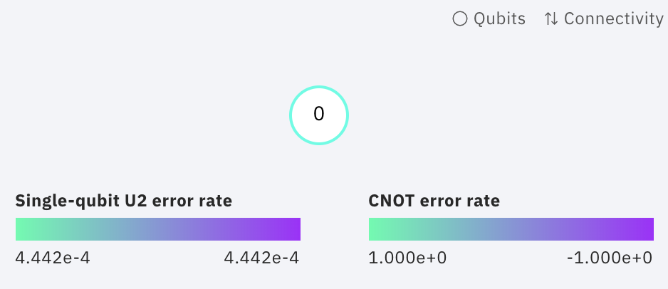
Error Mitigation with Qiskit Ignis: Rotation gate
Error mitigation
ibmq_armonk
Point | raw0 | raw1 | corr0 | corr1 | sim0 | sim1 | res_raw | res_corr | res_sim
0 | 7832.0 | 360.0 | 8150.693756 | 41.306244 | 8192.0 | NaN | 0.956055 | 0.994958 | 1.000000
1 | 7479.0 | 713.0 | 7721.837660 | 470.162340 | 7676.0 | 516.0 | 0.912964 | 0.942607 | 0.937012
2 | 6284.0 | 1908.0 | 6270.045251 | 1921.954749 | 6260.0 | 1932.0 | 0.767090 | 0.765386 | 0.764160
3 | 4719.0 | 3473.0 | 4368.742349 | 3823.257651 | 4371.0 | 3821.0 | 0.576050 | 0.533294 | 0.533569
4 | 3245.0 | 4947.0 | 2577.995544 | 5614.004456 | 2379.0 | 5813.0 | 0.396118 | 0.314697 | 0.290405
5 | 1812.0 | 6380.0 | 837.058953 | 7354.941047 | 827.0 | 7365.0 | 0.221191 | 0.102180 | 0.100952
6 | 1289.0 | 6903.0 | 201.671650 | 7990.328350 | 31.0 | 8161.0 | 0.157349 | 0.024618 | 0.003784
7 | 1434.0 | 6758.0 | 377.830742 | 7814.169258 | 278.0 | 7914.0 | 0.175049 | 0.046122 | 0.033936
8 | 2318.0 | 5874.0 | 1451.792874 | 6740.207126 | 1381.0 | 6811.0 | 0.282959 | 0.177221 | 0.168579
9 | 3850.0 | 4342.0 | 3313.003583 | 4878.996417 | 3206.0 | 4986.0 | 0.469971 | 0.404419 | 0.391357
10 | 5477.0 | 2715.0 | 5289.629353 | 2902.370647 | 5295.0 | 2897.0 | 0.668579 | 0.645707 | 0.646362
11 | 6930.0 | 1262.0 | 7054.863576 | 1137.136424 | 6949.0 | 1243.0 | 0.845947 | 0.861189 | 0.848267
12 | 7726.0 | 466.0 | 8021.915468 | 170.084532 | 8028.0 | 164.0 | 0.943115 | 0.979238 | 0.979980
Single qubit Rx $(0→2π)$
Rotation error mitigation
$\left|\left.ψ\right\rangle \right. → \left|\left.\tilde{ψ}\right\rangle \right.$ $=R\left|\left.ψ\right\rangle \right. → \left|\left.{\tilde{ψ}}_{mitigated}\right\rangle \right.=A^{−1}\left|\left.\tilde{ψ}\right\rangle \right.$
To be implemented on 2 sites Hubbard Model
https://github.com/Qiskit/qiskit-community-tutorials/blob/master/ignis/measurement_error_mitigation.ipynb

Slide 44
2 sites Error Mitigated real HW runs
Gates characterization: Rx & Ry
Each rotation correction brings 5 gates
Too many gates to correct all rotations
Gates characterization: CNOT
Verified that each consecutive CNOT brings an error
No particular way to correct it
Qiskit Ignis: Measurement Error Mitigation
Usage of Qiskit Ignis functions on involved qubits to mitigate errors

Slide 45
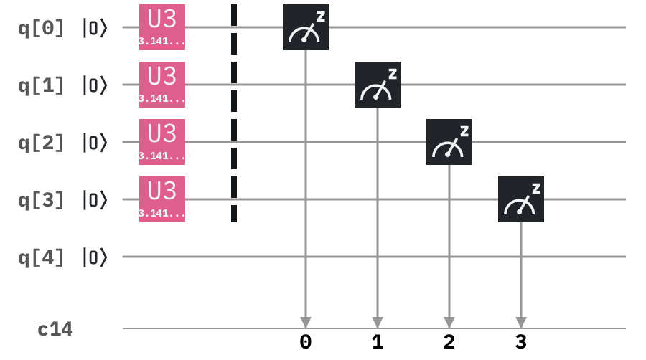
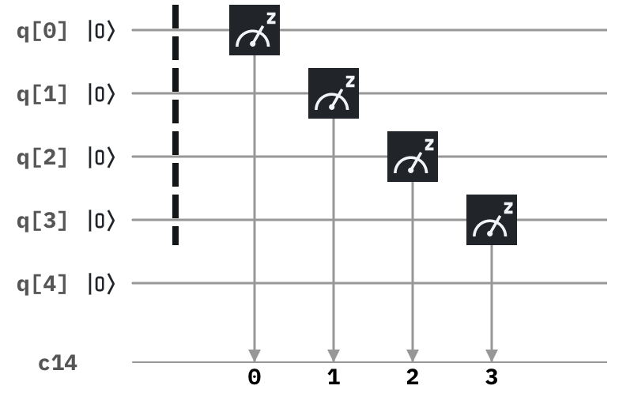
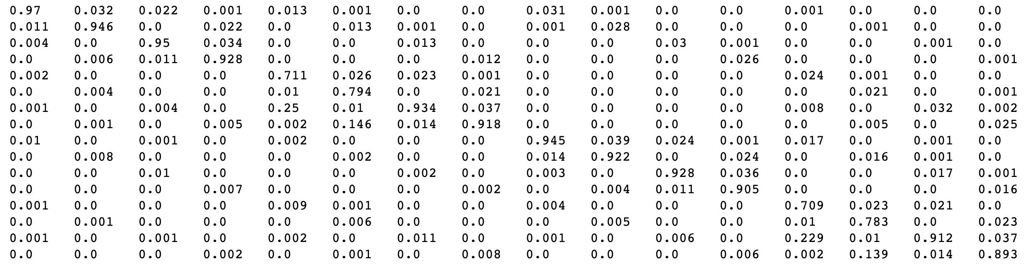
Qiskit Ignis Measurement Error Mitigation
Error mitigated runs
Calibration runs
Calibration matrix (approximated) – 16x16 for 4 qubits on ibmq_5_yorktown

Slide 46
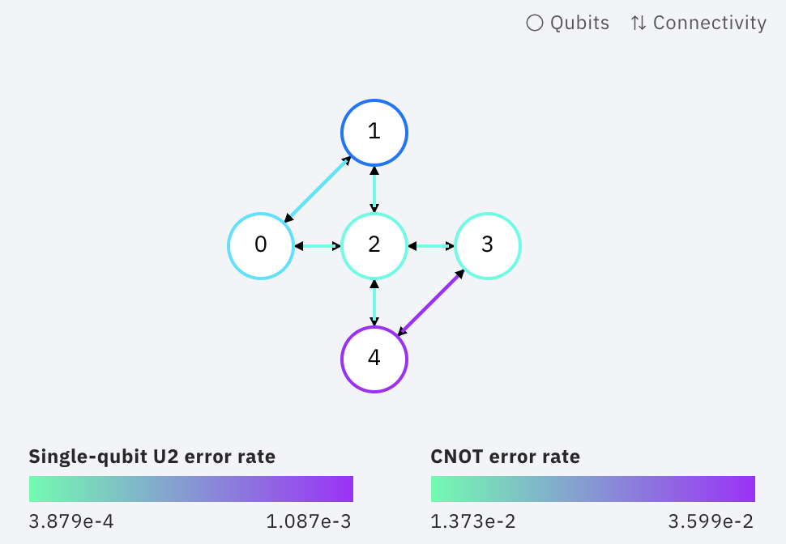
2 sites Ignis Error Mitigated HW runs
Error mitigated runs
“3.5 Trotter steps”
Mapping 2
ibmq_5_yorktown - ibmqx2 v2.0.0
REQUIRED CX
(0-1) x4 direct
(2-3) x4 direct
(0-3) x2 indirect
(1-2) x2 direct
Qiskit Ignis Measurement Error Mitigation
Initial state 1001, T=1, V=1, n1, nT=3+2°ordK
ibmq_5_yorktown - ibmqx2 v2.0.0
qubit_list=[0,1,2,3]
"_id": "cfbba9e6ef6459d30309a671793fcbe7"
NO CORRECTION
initial_layout = [0,1,2,3]
"depth": 83,
"gates": {
"u3": 106,
"cx": 90,
"barrier": 1,
"measure": 1
}
CORRECTION FACTOR 3.7
initial_layout = [0,1,2,3]
"depth": 83,
"gates": {
"u3": 106,
"cx": 90,
"barrier": 1,
"measure": 1
}
Very small correction from error mitigation due to circuit complexity

Slide 47
2 sites Hubbard HW run: outcomes
Error mitigated runs
1) Quantum chip
The best quantum chip to be used is IBM Q Yorktown (ibmq_5_yorktown) due to it’s topology matching quite well with needed CX gates.
2) Run parameters
Trotter steps: in range T ~ V, the number of nTrots increases circuit’s depth and gates. A 2° order Trotter step on kinetic term does not increase the quality of results at 1 or 2 nTrots.
Transpiling: optimization level 3 increases circuit’s depth and CX number, but it is not always bad.
3) Correction parameters
Start point: some runs do not start from the right point at 0, in particular at low nTrot (1 – 1.5).
Scaling correction factor: a correction factor can be obtained a posteriori to fit the theoretical distribution and to mitigate all the related kind of errors at the same time. Need to deepen how to calculate it a priori considering acquired calibration data.
Gates characterization: performed studies on rotation characterization cannot be used to mitigate systematic errors without increasing dramatically the number of gates. However, hints on % errors are shown in characterization runs.
Qiskit Ignis Error Mitigation: quite good results on Rotation error mitigation, accordance with simulations. However, Ignis error mitigation on 4 qubits on two sites Hubbard runs brings an small improvement on results.

Slide 48
Next steps
Qiskit Aqua benchmark to cross-check 2 sites model
Create Machine Learning model to understand best amplitude correction factor from calibration data
Perform J-V on the three sites Hubbard Model
Three sites Hubbard Model calculation with Qiskit Aqua

Slide 50
Backup

Slide 51
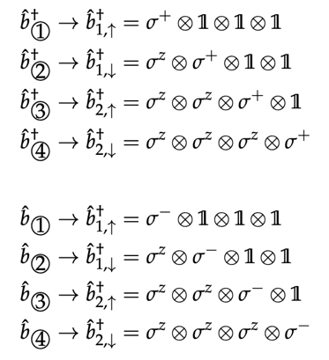
Jordan-Wigner transform
Introduction
Spin hamiltonian
Mapping 1
Observable: n1 = n1_up

Slide 52
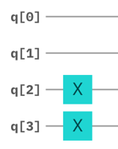
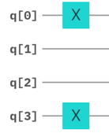
Spin hamiltonian to quantum circuit
Quantum circuit implementation
Initial state 1100
Initial state 1001
Building blocks
arXiv:1907.03505v1
arXiv:1907.03505v1
ZZ
ZZZ
XZX
arXiv:1907.03505v1
arXiv:1907.03505v1
XX
YY
YZY

Slide 53
Fermionic exact vs spin exact
Benchmark
Mapping 1
Initial state 1100, T=1, V=0, n1
Initial state 1100, T=1, V=1, n1
Initial state 1100, T=1, V=2, n1
Initial state 1001, T=1, V=0, n1
Initial state 1001, T=1, V=1, n1
Initial state 1001, T=1, V=2, n1

Slide 54
Spin exact vs trotter
Benchmark
Mapping 1
Initial state 1100, T=1, V=0, n1, nT=3
Initial state 1100, T=1, V=1, n1, nT=3
Initial state 1100, T=1, V=2, n1, nT=3
Initial state 1100, T=1, V=0, n1, nT=5
Initial state 1100, T=1, V=1, n1, nT=5
Initial state 1100, T=1, V=2, n1, nT=5

Slide 55
Spin exact vs trotter – High nTrot
Benchmark
Mapping 1
Initial state 1100, T=1, V=2, n1, nT=10
Initial state 1100, T=1, V=2, n1, nT=20
Initial state 1100, T=1, V=2, n1, nT=30
Initial state 1001, T=1, V=2, n1, nT=10
Initial state 1001, T=1, V=2, n1, nT=20
Initial state 1001, T=1, V=2, n1, nT=30

Slide 56
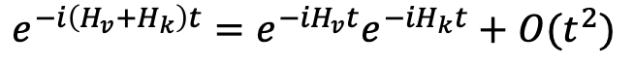
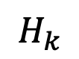
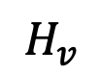
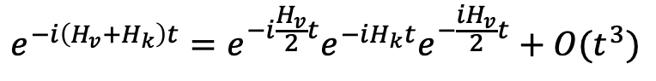
2° order Suzuki-Trotter decomposition
Quantum circuit optimization
OPTIMIZED (with 2° order S-T) on Hv
Initial state 1100, T=1, V=1, n1, nT=3
$$e^{−i\left(H_{v}+H_{k}\right)t}=e^{−{iH}_{v}t}e^{−{iH}_{k}t}+O(t^{2})$$
Expected better performances
S Trot
to
S Trot opt
overlying
$$H_{v}$$
carries 4 CNOT (2 in parallel)
$$H_{k}$$
(optimized) carries 8 CNOT (in series)
$$e^{−i\left(H_{v}+H_{k}\right)t}=e^{−i\frac{H_{v}}{2}t}e^{−iH_{k}t}e^{−\frac{{iH}_{v}}{2}t}+O(t^{3})$$
Hopping and interaction terms are composed by several subterms. In order to gain performances we expanded the interaction subterms, but no significant gain in performances occurred
NO TRANSPILING
Circuit Depth: 56
('cx', 48), ('rz', 48), ('ry', 24), ('rx', 24), ('u3', 2), ('measure', 1)
Single: 99 – Double: 48
TRANSPILED LEVEL 3
Circuit Depth: 52
('u3', 84), ('cx', 48), ('measure', 1)
Single: 85 – Double: 48

Slide 57
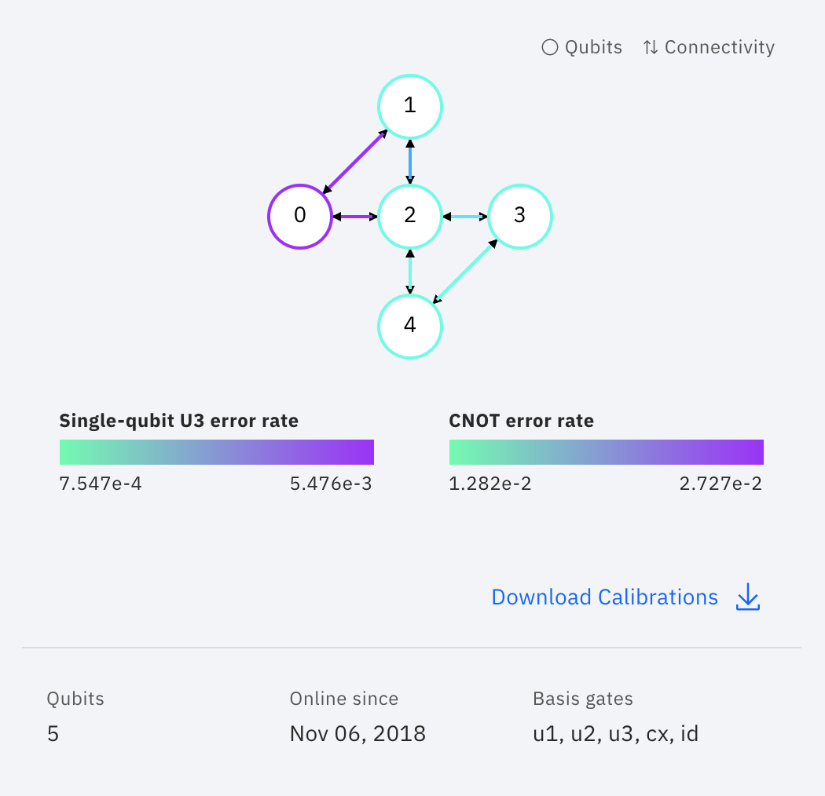
Run on real hardware
Tests on real HW
ibmq_qasm_simulator
ibmq_5_yorktown - ibmqx2 v2.0.0
Initial state 1100, T=1, V=1, n1, nT=1
Initial state 1100, T=1, V=1, n1, nT=1
corrected bug
NO TRANSPILING
Circuit Depth: 16
('cx', 12), ('rz', 10), ('ry', 8), ('rx', 8), ('u3', 2), ('measure', 1)
Single: 29 – Double: 12
NO TRANSPILING
Circuit Depth: 16
('cx', 12), ('rz', 10), ('ry', 8), ('rx', 8), ('u3', 2), ('measure', 1)
Single: 29 – Double: 12
TRANSPILED LEVEL 3
Circuit Depth: 13
('u3', 21), ('cx', 12), ('measure', 1)
Single: 22 – Double: 12
TRANSPILED LEVEL 3
Circuit Depth: 13
('u3', 21), ('cx', 12), ('measure', 1)
Single: 22 – Double: 12

Slide 58
Used qubit vs processor topology
Optimization tests
Specifying an Initial Layout
It is completely possible to specify your own initial layout. To do so we can pass a list of integers to transpile via the initial_layout keyword argument, where the index labels the virtual qubit in the circuit and the corresponding value is the label for the physical qubit to map onto.
# Virtual -> physical
# 0 -> 11
# 1 -> 12
# 2 -> 10
# 3 -> 2
# 4 -> 4
circ_tran = transpile(circ, backend, initial_layout=[11,12,10,2,4])
Force own layout
https://github.com/Qiskit/qiskit-iqx-tutorials/blob/master/qiskit/fundamentals/5_using_the_transpiler.ipynb

Slide 59
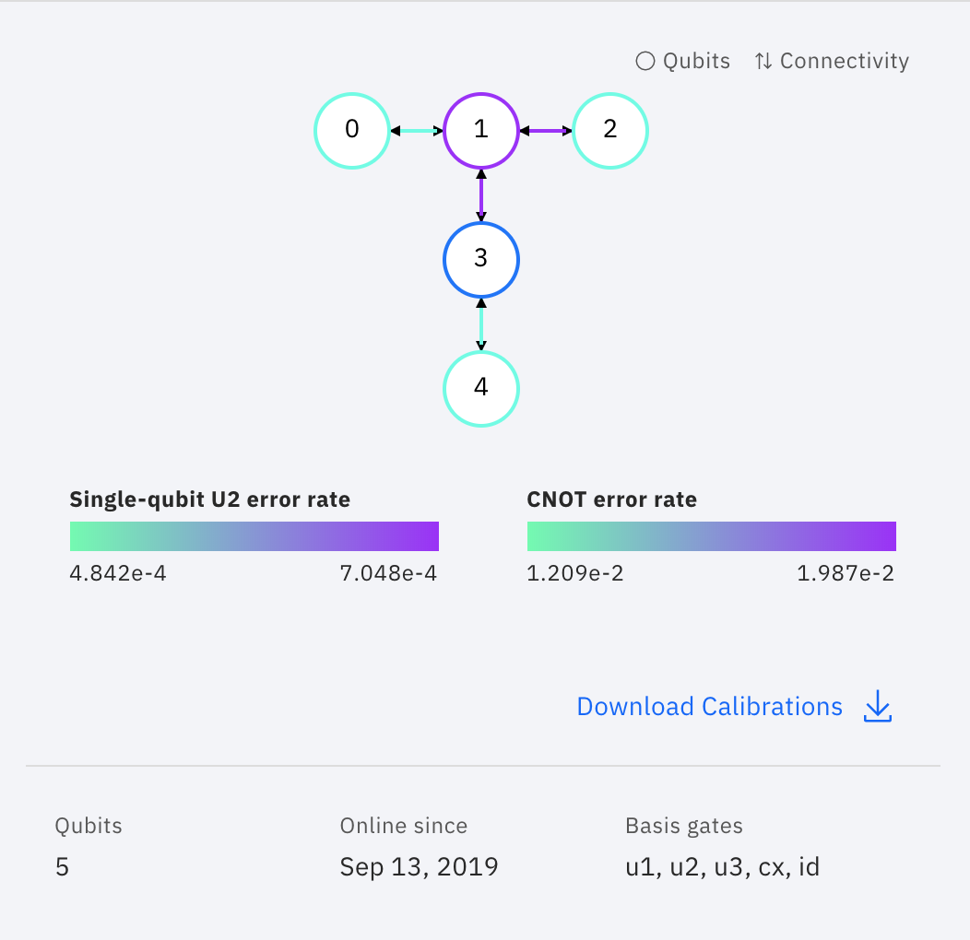
Gates characterization: Rx
Optimization tests
Best
Worst
ibmq_qasm_simulator
ibmq_burlington v1.1.4
Qubit 0
Qubit 1
"_id": "85b6bd4e391f835316b424292e09b5f9",
"_id": "ce390612ee693364473632ee70256765",
"_id": "be4c633900f98125a645be470dcb9463",

Slide 60
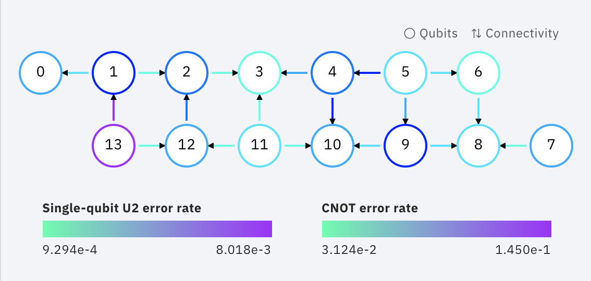
Gates characterization: Rx
Optimization tests
ibmq_qasm_simulator
ibmq_16_melbourne v1.0.0
Qubit 0
Qubit 1
"_id": "85b6bd4e391f835316b424292e09b5f9",
"_id": "5659f3270cc04ff4957b9ba03d304dcb",
"_id": "c3f13a3b103830ea3043da29bde31fac",
epsZ
epsY

Slide 61
Gates characterization: noisy Rx
Optimization tests
ibmq_qasm_simulator
ibmq_16_melbourne v1.0.0
EpsZ = pi/12
EpsZ = pi/13
EpsZ = pi/16
"_id": "5659f3270cc04ff4957b9ba03d304dcb",
EpsY = pi/8
EpsY = pi/16
EpsY = 0

Slide 62
Gates characterization: noisy Rx
Optimization tests
ibmq_qasm_simulator
ibmq_5_yorktown - ibmqx2 v2.0.0
EpsZ = pi/24
"_id": " 3897b28b0252ac905953c1fde4785bcd ",
EpsY = pi/24

Slide 63
Gates characterization: ratio plots
Optimization tests
epsZ = pi/13, epsY = pi/24, epsX = pi/24
epsZ = pi/13, epsY = pi/24, epsX = 0
epsZ = pi/13, epsY = 0, epsX = 0
ibmq_16_melbourne v1.0.0
"_id": "5659f3270cc04ff4957b9ba03d304dcb",

Slide 64
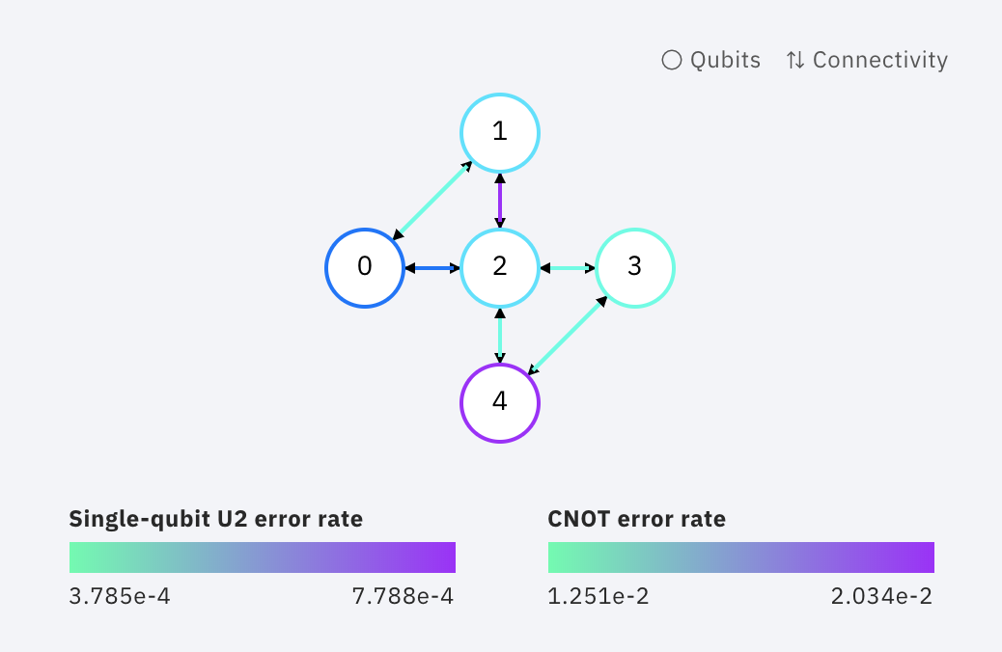
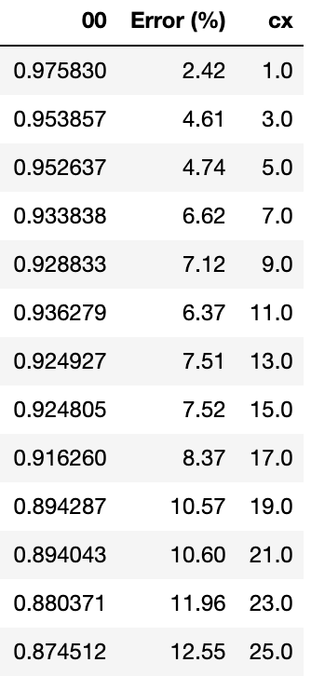
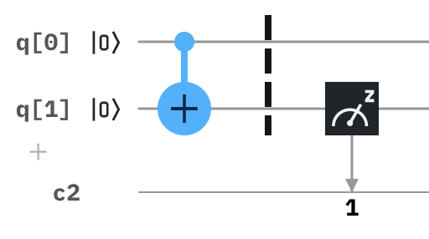
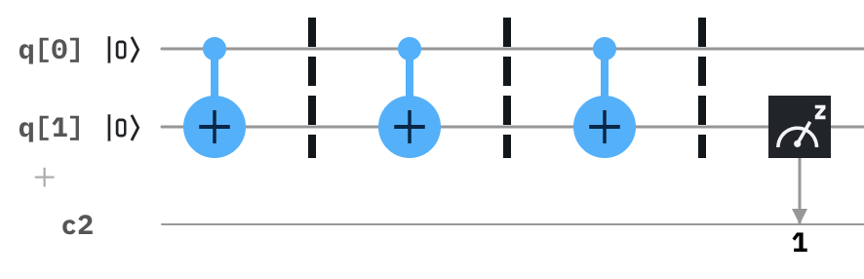
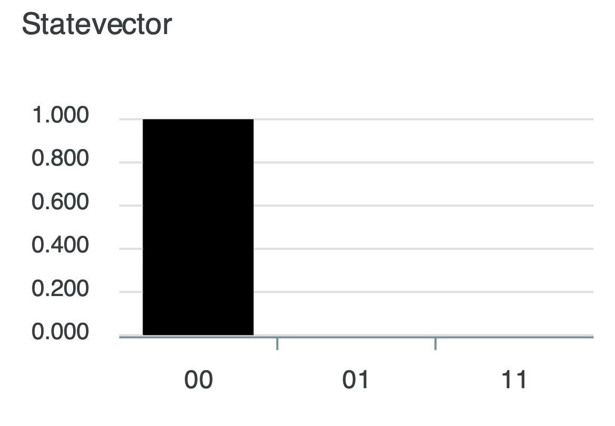
Gates characterization: CNOT
Error mitigation
From 1 to 25 CXs, odd steps
ibmq_5_yorktown - ibmqx2 v2.0.0
CIRCUIT
Optimization Level 0
Barriers to force gates layout (no transpiling / optimization / gates reduction)
1 CX
3 CX
…
25 CX
Result expected: 00 (100%)
Accuracy decreasing by adding CXs

Slide 65
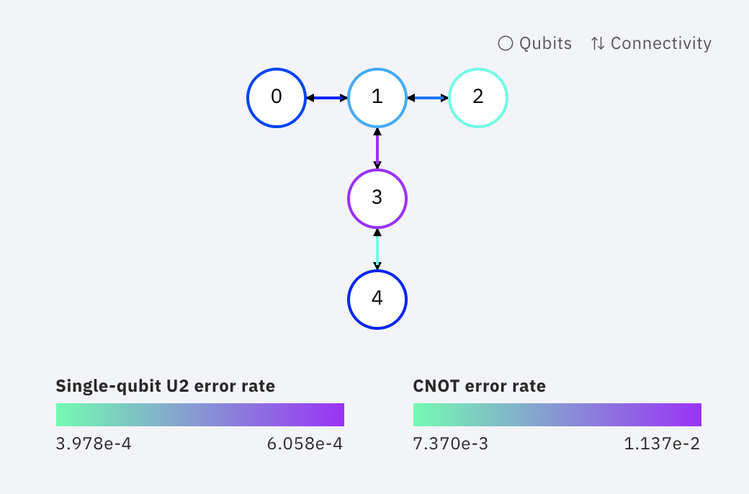
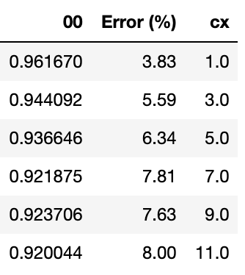
Gates characterization: CNOT
Error mitigation
From 1 to 25 CXs, odd steps
ibmq_vigo
CIRCUIT
Optimization Level 0
Barriers to force gates layout (no transpiling / optimization / gates reduction)
1 CX
3 CX
…
11 CX
Result expected: 00 (100%)
Accuracy decreasing by adding CXs

Slide 66
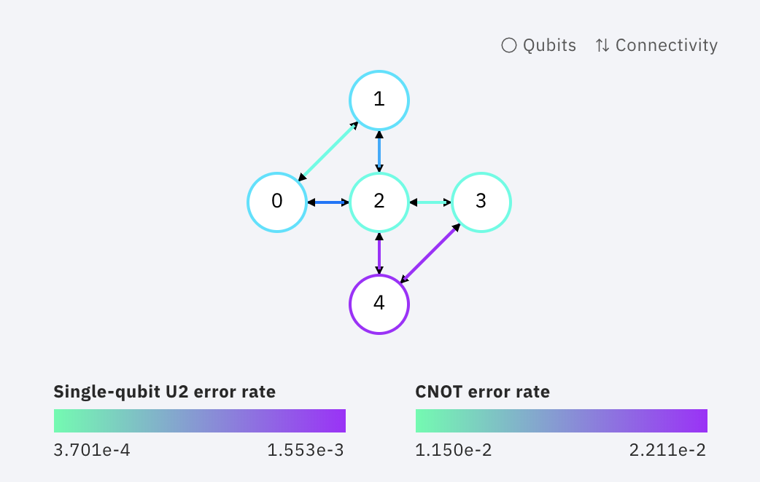
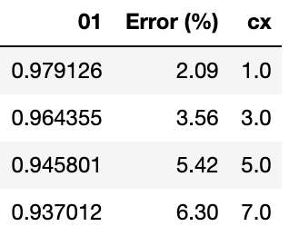



Gates characterization: CNOT
Error mitigation
From 1 to 25 CXs, odd steps
ibmq_5_yorktown - ibmqx2 v2.0.0
CIRCUIT
Optimization Level 0
Barriers to force gates layout (no transpiling / optimization / gates reduction)
Added initial perturbation
1 CX
3 CX
…
7 CX
Result expected: 01 (100%)
Accuracy decreasing by adding CXs

